Slide 1

Footstep Power Generator
Group Members:
1) Digvijay V. Ahirrao (Roll No. 01)
2) Amit V. Kamble (Roll No. 28)
3) Prashant M. Mishra (Roll No. 39)
4) Saurabh P. Parab (Roll No. 42)
Under the Guidance of:
Prof. J. P. Patil

Slide 2
Content
Introduction
Description
Survey of data
Objectives
What is Pizeoelectric Sensor?
What is Pizeoelectric Effect?
Problem statement
Purpose
Applicability/Feasibility Study
Literature survey
Sofware and Hardware requirements
Implementation Approach
System Design
Code Details
Working
Future Scope
Conclusion
References

Slide 3
Introduction
This Footstep Power Generation System is used to generate voltage using piezoelectric sensors.
This project can be implemented in public places like Night Clubs, shopping malls, railway stations, etc.
When an pressure is applied to piezoelectric sensors, then voltage is generated directly proportional to the applied pressure.
Piezoelectric sensors are used to measure force, pressure and an voltmeter and battery is used to measure voltage and to store the generated voltage.
These devices may then generate a voltage on every footstep and when mounted in series they will produce a sizeable amount of electricity.

Slide 4
Description
Due to increase in population, requirement and usage of power is increasing day by day.
Reforming renewable energy back to its usable form.
This energy is transformed using piezoelectric sensors.
Piezoelectric sensors convert the pressure into voltage.

Slide 5
Survey of Data
As we surveyed, Arduino is used over Raspberry Pi.
Arduino is powered using a battery while it is difficult to power Raspberry Pi using battery.
Raspberry Pi is expensive compared to Arduino.
Arduino is suitable for the task that need sensor data read and reacted to real time.
Arduino has low power requirement and low maintenance.

Slide 6
Objectives
To provide a non-conventional electrical energy production system.
To depict the use of piezoelectric effect by using mechanical force in electricity generation.
To provide eco-friendly and pollution free source for production of electricity.
To develop much cleaner cost effective way of power generation method which helps to cut down the global warming.
To use stored energy as renewable source of energy.

Slide 7
What is Piezoelectric Sensor ?
Piezoelectric Sensor uses piezoelectric effect to measure pressure or mechanical energy by converting all of it to electrical energy signals.
It is a substantial tool that could be used for the measurement of varying cause.
It has very high modulus of elasticity compared to other metals.
Additionally, piezoelectric sensors are rugged, have high natural frequency.
This phenomenon is not affected to Electromagnetic fields and other radiations.

Slide 8
What is Piezoelectric Effect ?
Piezoelectric Effect or Piezoelectricity is the ability of certain materials to generate an AC voltage when subjected to mechanical stress.
When piezoelectric material is placed under mechanical stress, a shifting of the positive and negative charge centers in the material takes place
Piezoelectricity has both direct and converse effects i.e. mechanical stress results in AC voltage generation and vice-versa.

Slide 9
Problem Statement
To generate electrical energy from the footsteps there are several methods i.e. gear wheel and fly wheel to produce power.
These are used in places where there is a lot of people’s movement to generate power because the mechanical portion of this will work on the principle.
Footstep from crowed on floor and piezo plate scheme that is used below the floor is done for the generation of power, piezo plate will be covered by the sheet and piezo sensor experience a vibrating force by the spring.

Slide 10
Purpose
The purpose of this project is to generate electricity using mechanical force.
It can also be used in public places where it can generate electricity in large scale.
Electrical power can be generated using fly wheel and gear wheel.
Mechanical Parts are placed where number of people are more and energy produced by their movement is converted into usable form.
The crowd can generate power on the floor by their footsteps.

Slide 11
Applicability/Feasibility Study
A feasibility study is an analysis that takes all a project’s relevant fact into account to ascertain the likelihood of completing the project successfully.
This project is economically feasible. The project can be completed in time and its cost efficient. All the factors like.
1] Cost of hardware.
2] Cost of maintenance.
3] Cost of implementation of resources are taken into consideration.
A brief description of the business to assess more possible factors which could affect the study.
The human and economic factor.
The possible solutions to the problem.

Slide 12
Literature Survey
The papers used in this survey discusses the use of piezoelectric material to generate electricity Piezoelectric materials were known as smart materials due to the ability to produce electricpotential in response to applied mechanical actions.
The materials are expected to become another advantage for automotive industry and also in alternative power generation field. It is shown that with proper configuration, a singlepiezo-film can generate enough electrical density to be used for any application.
The purpose of the study is to generate electricity by using the piezoelectric effects.
Also we made the use of LCD Display so as to display the current produced as done in the ARDUINO POWER GENERATING USING HUMAN FOOT STEP paper.
In the Power Generation Using Piezoelectric & Thermoelectric from Footstep Technique Paper to overcome energy requirements electricity is generated by using biodegradable waste by burning it and also production of electricity with piezoelectric Sensors.

Slide 13
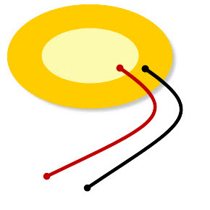
Software and hardware requirement
Hardware requirements:
Piezoelectric sensor –
A piezoelectric sensor is an electric device which is used to measure acceleration, pressure, or force to convert them to an electric signal.
These sensors are mainly used for process control, quality assurance, research and development in various industries.
The applications of this sensor involve, aerospace, medical, nuclear instrumentation, and as a pressure sensor it is used in the touch pad of mobile phones.
Piezoelectric sensor

Slide 14
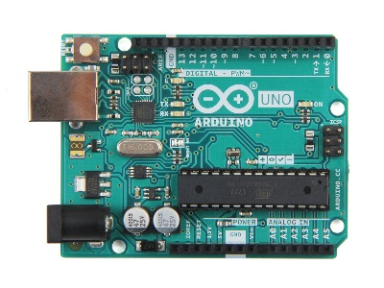
Arduino board
Arduinoboard is used for connecting microcontroller to the components and for running and executing the code.
Arduino is powered using a battery backup.
Arduino Board

Slide 15
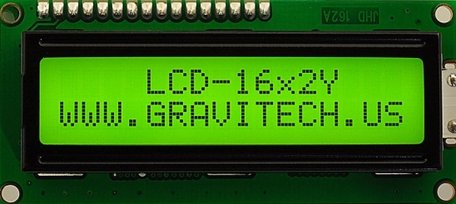
16x 2 LCD displays-
A 16X2 LCD display is used in the footstep power generation project to display the voltage status.
It is also provided with a contrast adjusting pin.
LCD Display

Slide 16
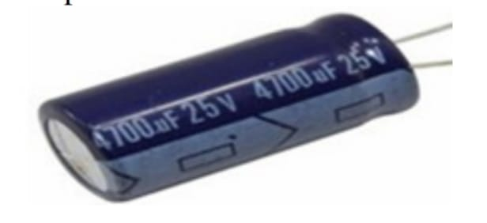
Capacitor
It is a passive two-terminal electrical component used to store energy electro statically in an electric field . It used to removes ripples from pulsating DC voltage by shorting to the ground AC signals and allowing DC signals to flow to the regulator for further process. The forms of practical capacitors vary widely, but all contain at least two electrical conductors (plates) separated by a dielectric (i.e. insulator).
The conductors can be thin films, foils or conductive electrolyte, etc. A dielectric can be glass, ceramic, plastic film, air, vacuums, paper, and mica. The non-conducting dielectric acts to increase the capacitor's charge capacity. An ideal capacitor does not dissipate energy but stores in the form of an electrostatic field between its plates .

Slide 17

Software Requirements
Arduino Compiler –
Arduino IDE is an open source software that is mainly used for writing and compiling the code into the Arduino Module.
Arduino Compiler

Slide 18
MC programming language C-
MC programming language C-
Embedded C is most popular programming language in software field for developing electronic gadgets.
Each processor used in electronic system is associated with embedded software.
Embedded C programming plays a key role in performing specific function by the processor.

Slide 19
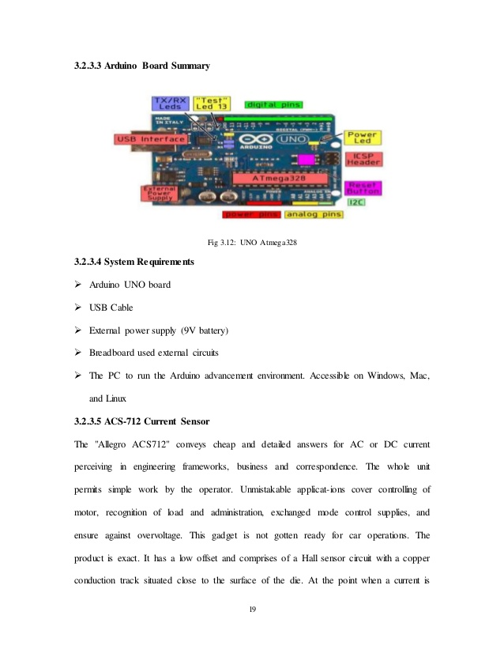
Implementation Approach
1) Arduino Module
Arduino board designs use a variety of microprocessors and controllers. The boards feature serial communications interfaces, including Universal Serial Bus (USB) on some models, which are also used for loading programs from personal computers. The microcontrollers can be programmed using C and C++programming languages. In addition to using traditional compiler tool chains, the Arduino project provides an integrated development environment (IDE) based on the Processing language project.

Slide 20
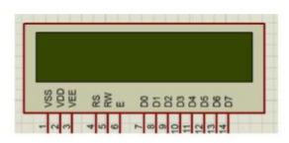
2) LCD Display Module
A liquid-crystal display (LCD) is a flat-panel display or other electronically modulated optical device that uses the light-modulating properties of liquid crystals combined with polarizer. Liquid crystals do not emit light directly, instead using a backlight or reflector to produce images in colour or monochrome. LCDs are available to display arbitrary images with low information content such as preset words, digits, and seven-segment displays, as in a digital clock. They use the same basic technology, except that arbitrary images are made from a matrix of small pixels, while other displays have larger elements.

Slide 21
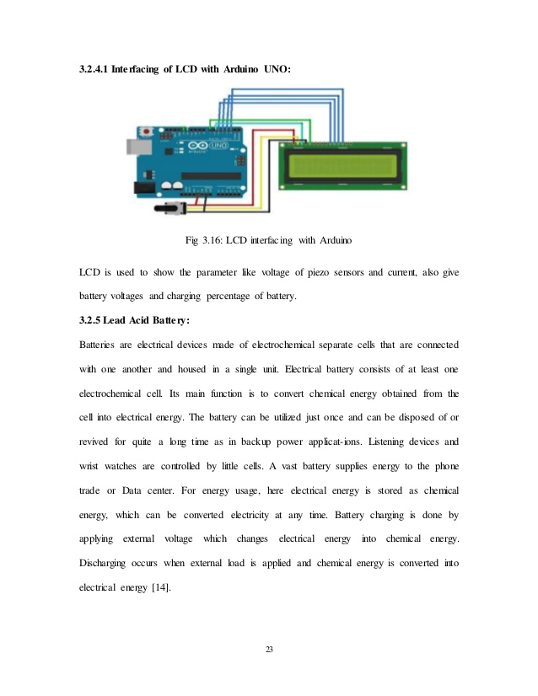
3) LCD interfacing with Arduino module
LCD is used to show parameters like voltage of piezo sensors and current, also give battery voltages and percentage of battery

Slide 22
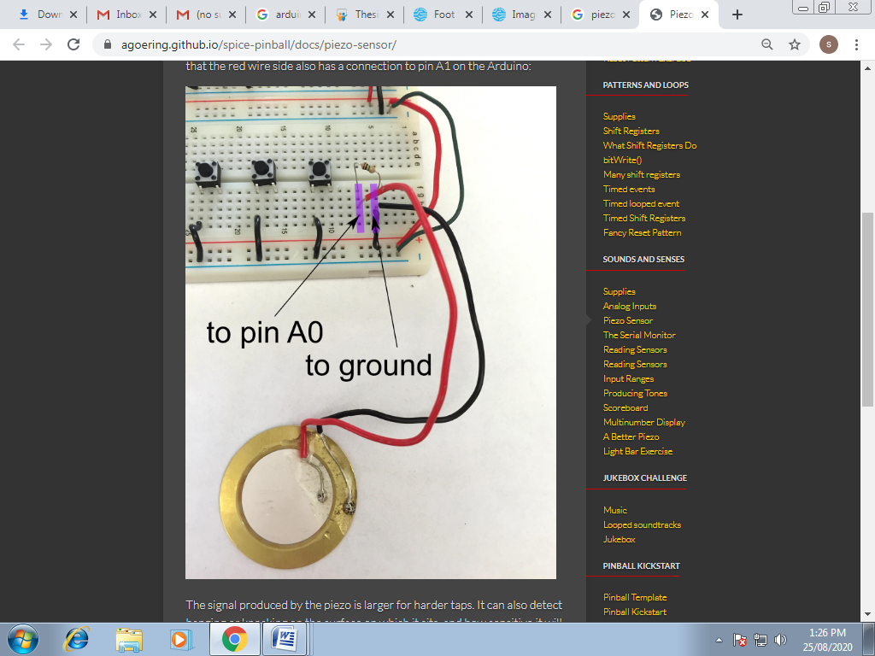
4) Piezoelectric Sensor Module
A piezoelectric sensor is made up of piezoelectric material (quartz-most used). It used to convert the mechanical stress into electrical charge. The output of the Piezoelectric Sensor is AC. The output of piezoelectric sensor or can store it into battery or other storage devices. The operating and storage temperature range is -20°C~+60°C and -30°C~+70°C respectively.

Slide 23
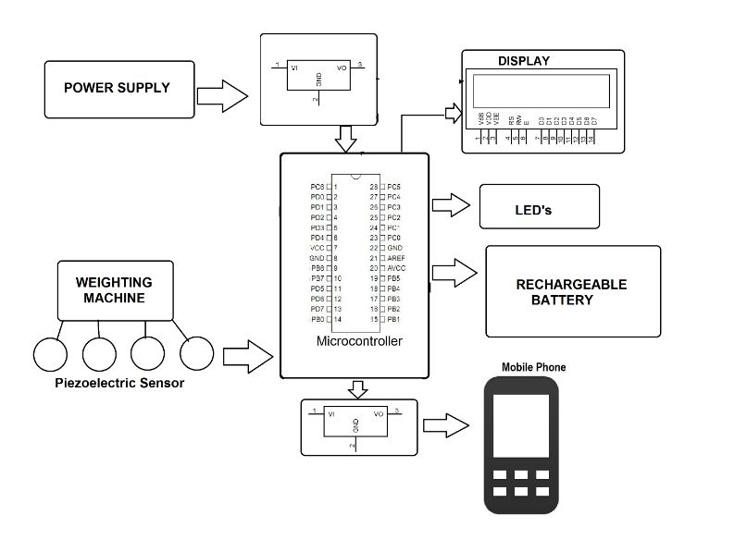
System Design
Block Diagram:

Slide 24
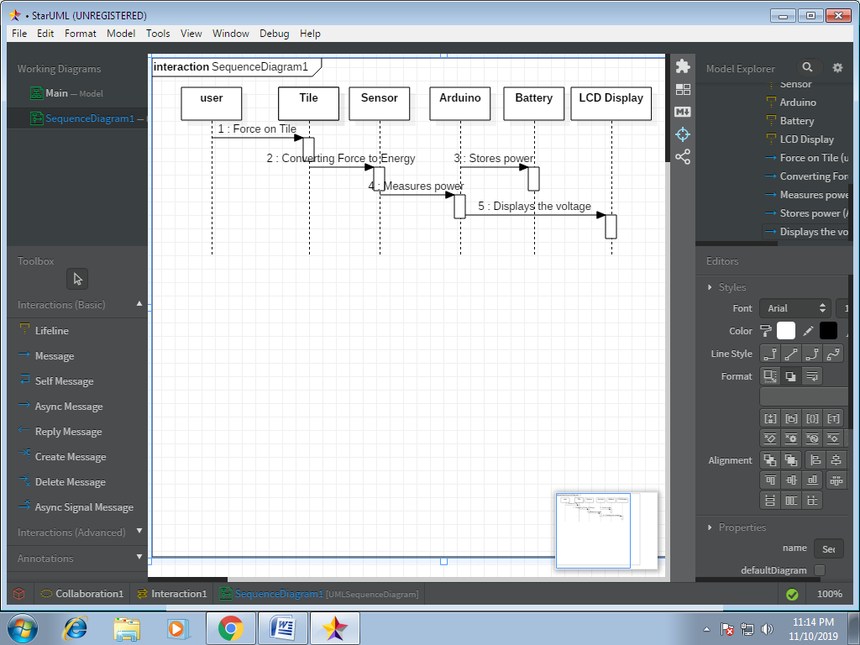
Sequence Diagram

Slide 25
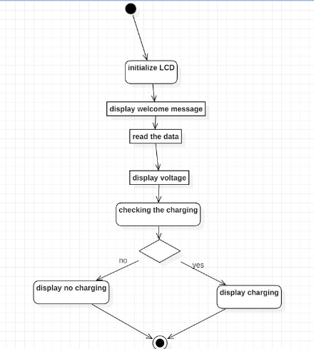
Activity Diagram

Slide 26
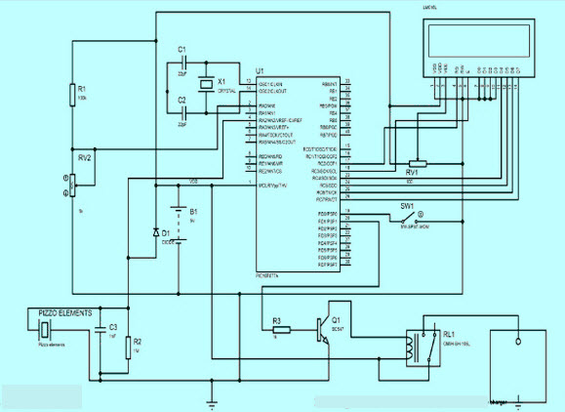
Circuit Diagram

Slide 27
Code Details
// Include Libraries
#include "Arduino.h"
#include "LiquidCrystal.h"
#include "PiezoSensor.h“
// Pin Definitions
const int rs =12, en=11, d4=5, d5=4, d6=3, d7=2;
int PIEZOSENSOR_PIN_POS=A5;
// object initialization
LiquidCrystal lcd (rs, en, d4, d5, d6, d7);
PiezoSensor pizeoSensor(PIZEOSENSOR_PIN_POS);
// define vars for testing menu
const int timeout = 10000; //define timeout of 10 sec

Slide 28
// Setup the essentials for your circuit to work. It runs first every time your circuit is powered with electricity.
void setup()
{
Serial.begin(9600);
while (!Serial) ; // wait for serial port to connect.
Serial.println("start");
// set up the LCD's number of columns and rows
lcd.begin(16, 2);
}
// Main logic of your circuit. It defines the interaction between the components you selected. After setup, it runs over and over again, in an eternal loop.
void loop()
{

Slide 29
.
// Piezo Element - Test Code
int piezoSensorVal = piezoSensor.read();
Serial.print(F("VOLTAGE: "));
Serial.println(piezoSensorVal);
lcd.clear();
lcd.setCursor(0,1);
lcd.print(“VOLTAGE:”);
lcd.print(piezoSensorVal);
delay(100);
}

Slide 30
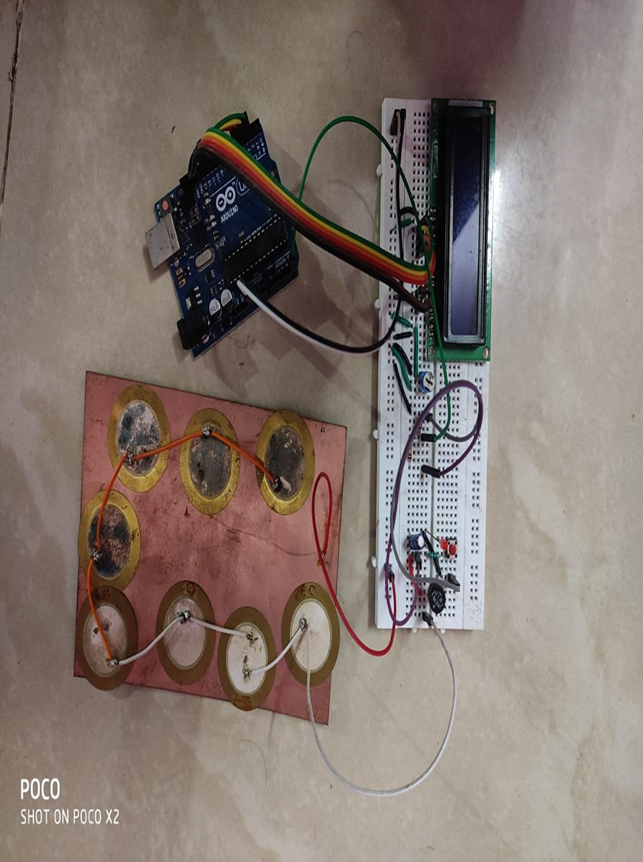
Working of Project

Slide 31
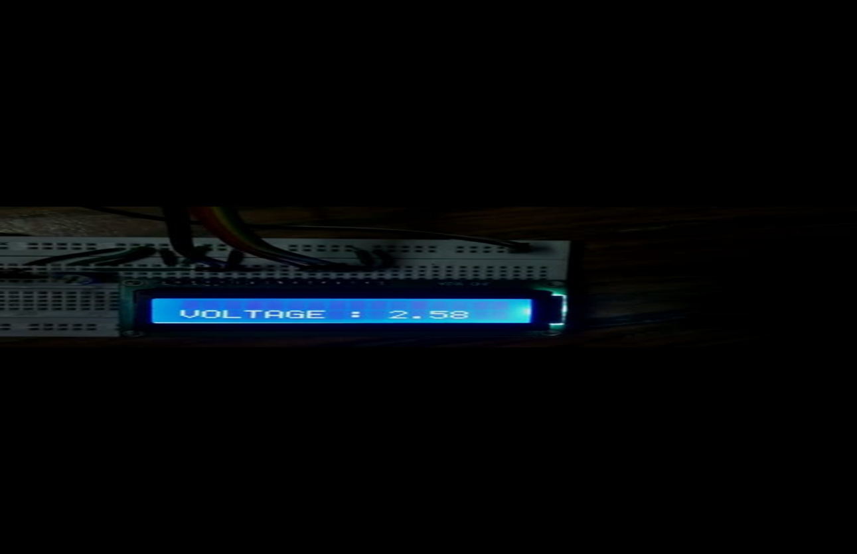
Result

Slide 32
Future Scope
The utilization of wasted energy is very much relevant and important for highly populated countries in the world in the future.
Flooring Tiles Japan has already started experimenting with the use of the piezoelectric effect impact on generating energy. They implement a piezoelectric effect on the bus stairs. Thus every time passenger steps on the tiles,the pizeo-electric effect will lead to generation of electricity.
The piezoelectric sensors when used on large scale will give positive result. In India, maximum public movement is observed in railway stations, temples, and shopping malls; hence this places can be equipped with platforms with piezoelectric sensors for generation of electric power.
Dance floors Europe is one of the countries which implemented and started experimenting with the use of a piezoelectric crystal for energy generation in night clubs.

Slide 33
.
Charging stations for mobile phone can be made available which will use approach of electricity generation to pizeo-electric sensor
Street light can be powered through the road by embedding pizeo-electric crystal into the road.
By installing pizeo-electric crystal at the rear end of the shoes,with every steps the pressure on the shoes can generate enough energy to charge small electronic gadget or devices.

Slide 34
Conclusion
Footsteps are the main source of power generation. There is no need of energy from conventional source of energy and there is zero percent of pollution in this type of power generation. There is no need of any kind of power from mains and it is important to the areas, all tracks where non-conventional energy is used as electricity. The contribution of Non-conventional energy to our primary energy is 11% that is a common fact. If this project is activated it will not only add and overwhelm the energy deficit problems but this will also form global environmental change.
This technique produces electricity with the assistance of electricity components that create use of the energy of human footsteps. The converter employed in the circuit stores the charge for future applications. So as to extend the potency of the total system if super capacitors and converter square measure employed in place of the standard ones then a lot of charge will be hold on than the standard ones. The super capacitors store and discharge energy while not intense abundant energy. Thus, the need of constant increase of power will be met by putting in these systems in heavily packed places. This may doubtless not solely overcome the energy crises however conjointly build up a healthy encompassing

Slide 35
References
S. Kumar, S. Mittal, S. Saini, V. Pal, Foot Step Energy Conversion System, 7(5), 132–136, (2016)
M. I. Abdullah, Piezoelectric Effect on Generation on Electricity, Final Year Project Thesis, UniKL MIAT, (2013)
A. Patil, S. Pawar, D. Chavan, Y. Borde, International Journal Of Innovative Science, Engineering And Technology (IJISET), 4(2), 379–381, (2017)
Ali, Adeel and Khan, Usama and Ahmad, Md. Omair and Aziz, Asfia and Neha, Neha (2021) Footstep Power Generation Using Piezoelectric Sensor. In: ICIDSSD 2020, 27-28 February 2020,
Wang Lijing;Shi Liping“Simulation of the self-sensing actuators based on multi-piezoelectric effects of piezoelectric crystal”,2011 International Conference on Electronics & Mechanical Engineering and Information Technology,pp.1876-1879,2011.

Slide 36
.
Elham Maghsoudi Nia, Noor Amila Wan Abdullah Zawawi, Balbir Singh, Mahinder Singh, “A review of walking energy har-vesting using piezoelectric materials”, International Conference on Architecture and Civil Engineering , pp. 1-7,2017.
Pramathesh.T,Ankur.S,(2013)“Piezoelectric crystals:Future source of electricity”, International Journal of Scientific Engineering and Technology, Vol 2 Issue 4, pp .260-262,2011.
”Utilization of Pedestrian Movement on The Sidewalk as A Source of Electric Power for Lighting Using Piezoelectric Censors”,2018 3rd International Conference on Intelligent Transportation Engineering,pp.241-246,2018.
“Generation and utilization of electricity using footsteps as a source of energy”,2020 International Conference on Recent Trends on Electronics, Information, Communication & Technology,pp. 378-382 ,2020.

Slide 37
.
https://www.google.com/search?sxsrf=ALeKk01FLYO aTMmZkikPjhbxjH7IvYncg:1621408003619&q=capacitor+25v&tbm=isch&chips=q:capacitor+25v,g_1:4700uf:0FfhgD4pLPA%3D&usg=AI4_-kQPGChtKt-QpxzNnzeMqShM3NCPNg&sa=X&ved=2ahUKEwiUvN3Al9XwAhXjwjgGHdFyBfEQgIoDKAB6BAgDEAY&biw=1366&bih=578#imgrc=XT-GZ8HtRmZd0Mhttps://www.scribd.com/document/365438531/Foot-Step-Power-Generation-Project-Report
https://www.google.com/search?rlz=1C1CHBD_enIN838IN838&sxsrf=ACYBGNQs8CFjYQ9oK-un4FpB9VeB37yK5Q:1570853380971&q=advanced+footstep+power+generation+system+using+arduino&sa=X&ved=2ahUKEwjCjZHu7JXlAhWKXCsKHVMOAEgQ1QIoBHoECAoQBQ&biw=1024&bih=657

Slide 38
.
http://www.smartkitprojects.com/advanced-footstep-power-generation-system-with-arduino.html?___store=english
https://www.researchgate.net/publication/308120087_Footstep_Power_production_using_Piezoelectric_Sensors

Slide 39
Thank you

